Slide 1
PILOT 1 DESIGN RENDERS
MICRO MARKET EXPEREINCE

Slide 2


Slide 3


Slide 4
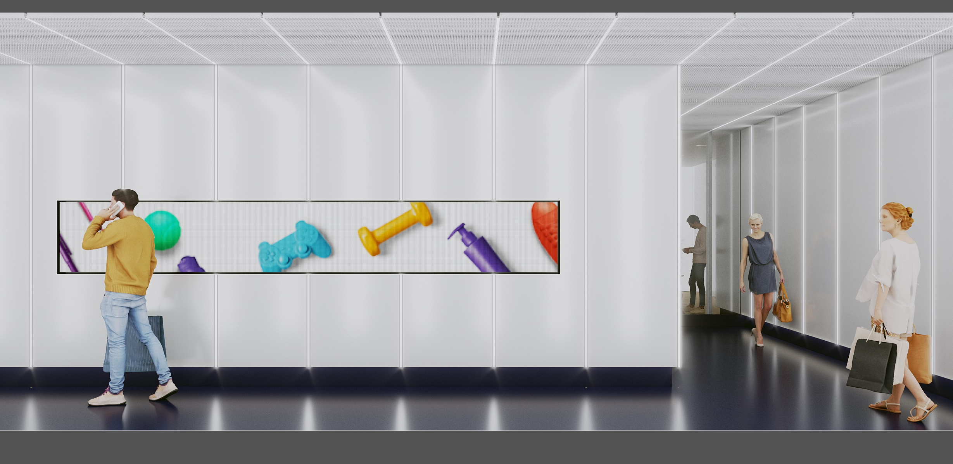

Slide 5
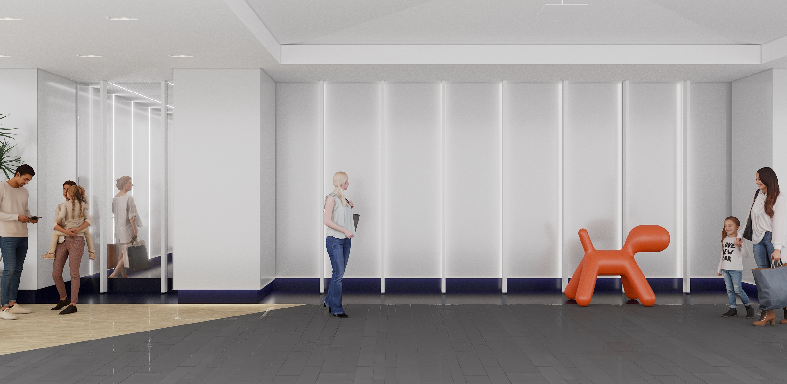

Slide 6
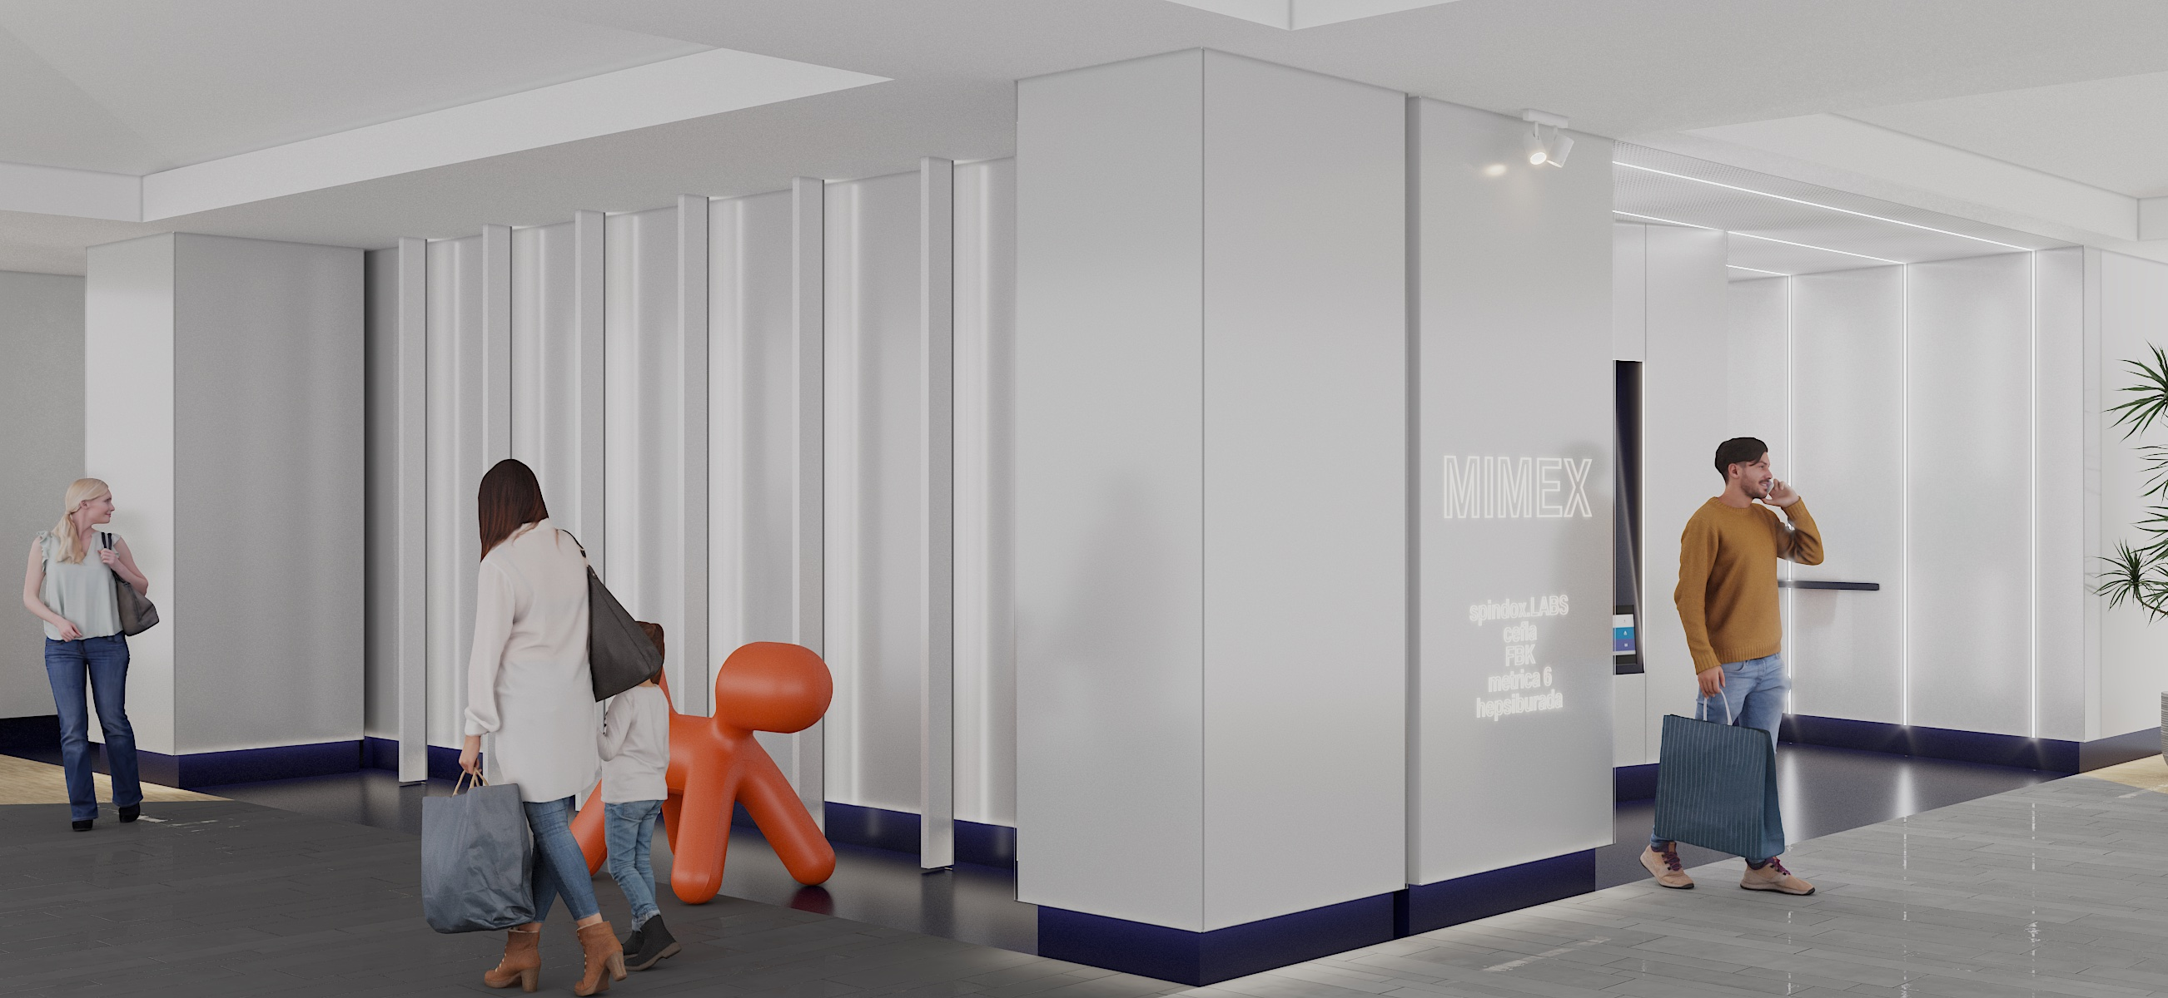

Slide 7
